Slide 1

RPA: Automated Bank Reconciliation System
Riddhika
Snegha Valli
Shuruthi Ajay

Slide 2

Problem statement:
Manual reconciliation of bank statements with internal departmental records is a time-consuming and error-prone process. Organizations often deal with multiple Excel files from different companies and departments, making it difficult to identify mismatches, missing entries, and incorrect transactions efficiently. There is a need for an automated solution that can accurately compare data across multiple sources, reduce human effort, and improve reconciliation accuracy.

Slide 3
Objectives:
1
Automating the entire bank reconciliation process using the UiPath tool will lead to a reduction of manual efforts and faster processing.
2
To read, validate, and process financial data contained in multiple Excel files of different companies and departments.
3
Comparison of the bank transactions with the records in the departmental systems.
4
Automated classification of transactions into three categories based on specific conditions.
5
To avoid errors, manage a huge amount of financial data, and produce reconciliation reports.

Slide 4



Literature survey

Slide 5

01
Automation of Rule-Based Financial Processes
Robotic process automation is gaining immense traction in finance and banking, considering the fact that this technology is able to automate rule-based operations. According to a systematic review done by Judith Wewerka and Manfred Reichert in 2020, robotic process automation works best in cases where actions are rule-based because it provides room for automation in an environment where everything is structured. In this sense, it can be said that financial activities such as financial reconciliations are easily amenable to automation because they are very structured.

Slide 6
RPA Adoption in Financial Institutions
02
Itescribes the application of RPA tools powered by UiPath in banking firms for automating Excel work processes and legacy system integration. Processes such as reconciliation and reporting are reported to be able to be automated using such processes to achieve up to 50% efficiency improvements in them, making them fast and accurate. It is therefore apparent that activities in finance are indeed very amenable to automation through RPA tools.

Slide 7
03
Automation of Financial Reconciliation Processes
Moreover, further research on the automation of financial reconciliation conducted by Pholarin Matin (2024) shows that conventional reconciliations are resource-intensive and error-prone, while robotic process automation is characterized by increased accuracy and scalability, ensuring compliance. The findings reveal that financial automation allows for efficient processing of transactions, eliminating the need for manual involvement, which makes it appropriate for transaction-intensive situations.
Furthermore, according to the industry report published by UiPath, finance and accounting organizations encounter difficulties owing to numerous financial transactions and outdated technology infrastructure. Robotic process automation enables solving these problems by streamlining the data extraction, verification, and comparison procedures through various sources, including Excel files and other platforms within the organization. Moreover, case studies demonstrate the effectiveness of automated bank reconciliation.

Slide 8
Methodology

Slide 9
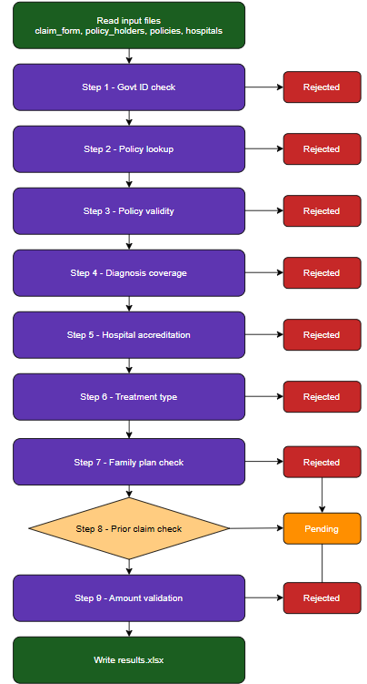

MODEL PIPELINE

Slide 10

Data Input
1
  Read company-wise bank statements from Excel files
  Read department-wise records from separate Excel sheets
Methodology
2
Data Processing
  Loop through each company (For Each companyName)
  Loop through each department (For Each currentText)
  Merge department data into a consolidated table
Data Comparison
3
  Iterate through each bank transaction
  Identify department based on transaction description
  Match bank data with department records using:
    Amount (CR/DR)
    Description
    Department
Decision Logic
4
  If no match → “Missing in company”
  If match found:
    If amount matches - “Matched”
    Else - “Amount mismatch”
Output Generation
5
  Store results in a report DataTable (dtReport)
  Write final reconciliation report to Excel

Slide 11

The methodology follows a structured pipeline implemented in UiPath Studio. The solution is designed using a modular multi-file architecture, where the main workflow orchestrates the complete reconciliation process, and reusable components handle specific tasks such as reading data, processing transactions, and writing results. The workflow iterates through multiple company files and department datasets, ensuring scalability and efficient handling of large volumes of financial data.
The datasets are divided into two primary sources. The bank statement files (Bank.xlsx) contain transaction-level details such as date, description, debit/credit amounts, and reference information. The department-wise Excel files represent internal records, including department name, transaction details, descriptions, and corresponding debit/credit values. These datasets are dynamically read and processed for each company and department.

Slide 12


Result
What we give as input:
  Bank.xlsx - contains bank statement transactions with details such as Date, Description, Debit/Credit (CR/DR), Amount, and Reference Number.
  Department files (.xlsx) - multiple Excel files for each department containing internal transaction records such as Date, Description, Department Name, Debit/Credit values, and Amount.
  Company-wise files - separate bank files for each company processed dynamically using company names.
What we get as output:
  Reconciliation_Report.xlsx - contains one row per transaction with columns such as Company Name, Date, Description, Amount, Department, Status (Matched / Amount Mismatch / Missing in Company), and Remarks.

Slide 13
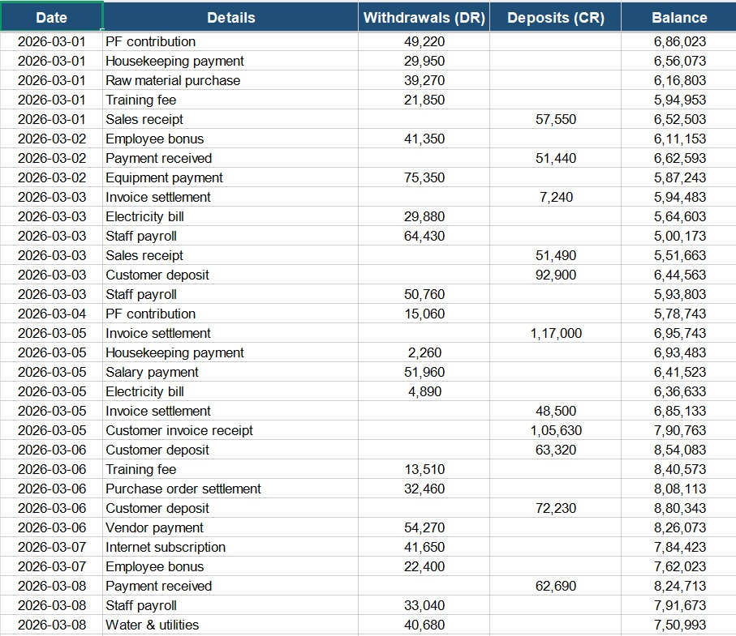
Company C bank records:

Slide 14
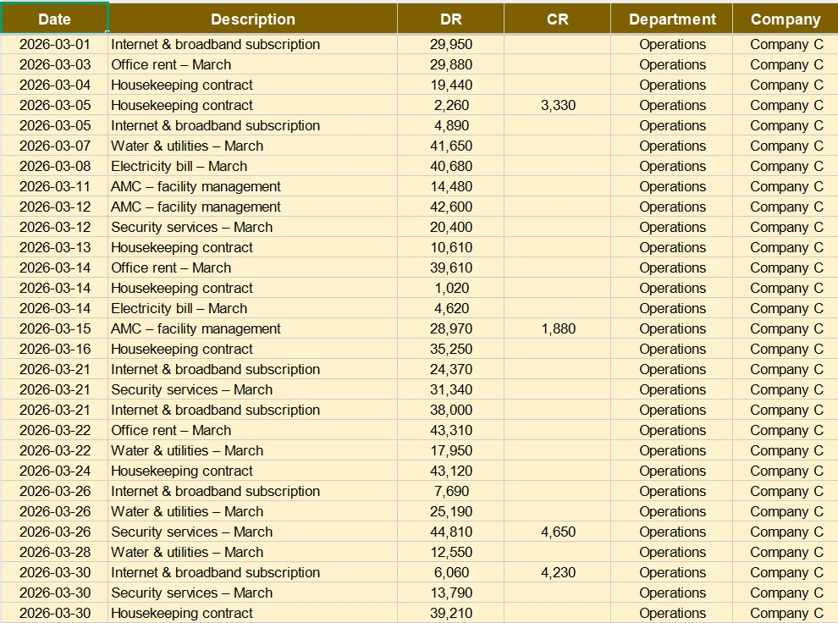
Company C records:

Slide 15
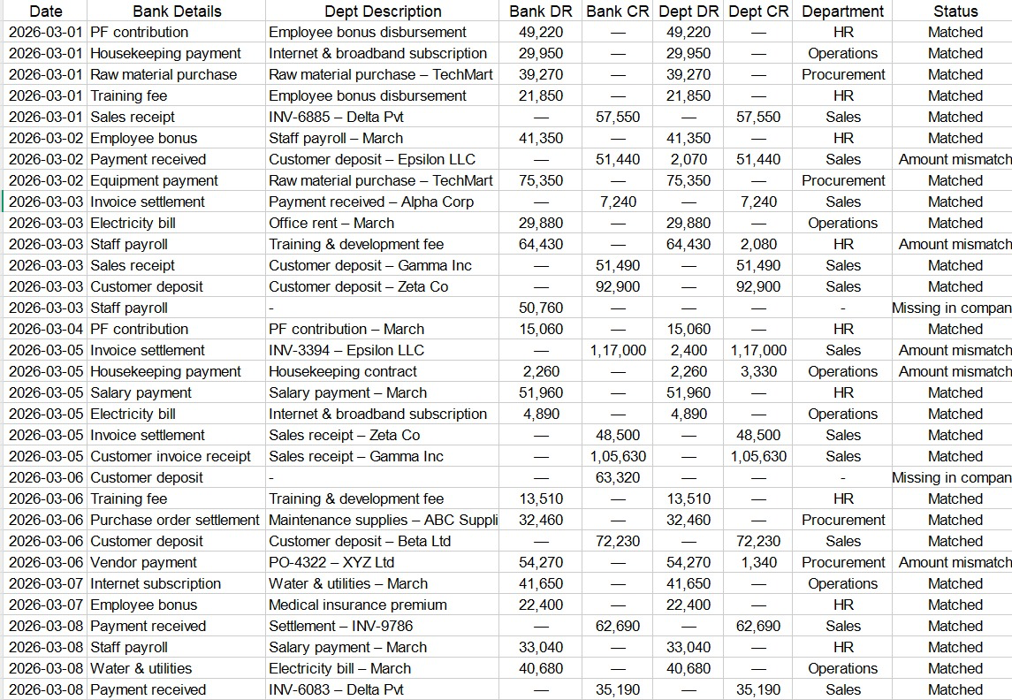
Reconciliation Report of Company C

Slide 16
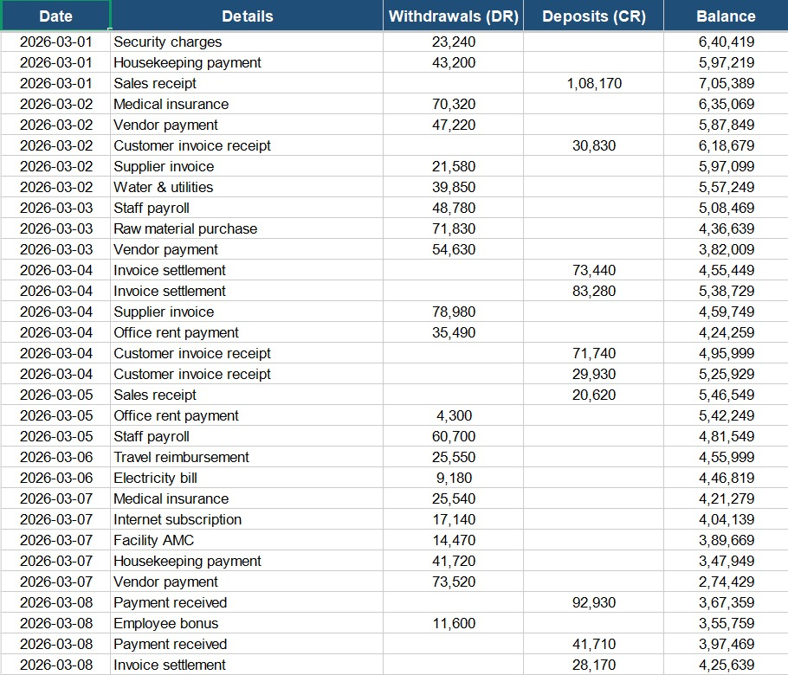
Company A bank records:

Slide 17
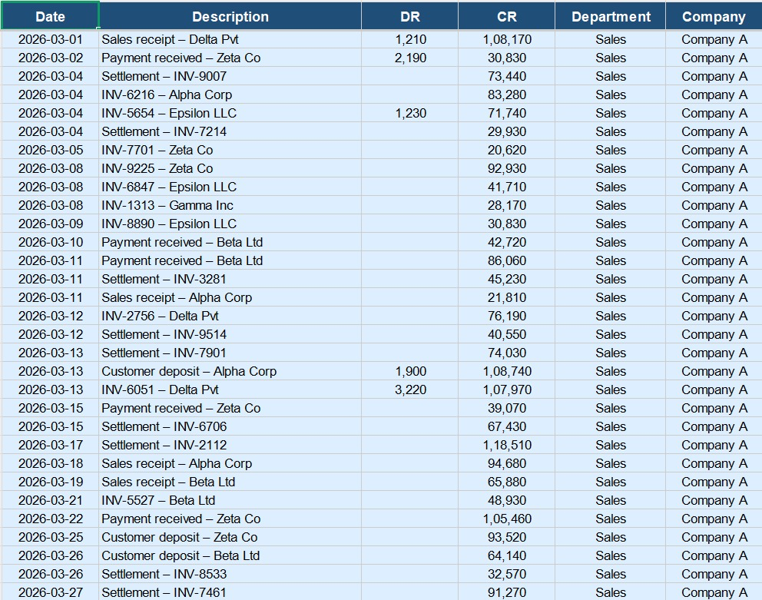
Company A records:

Slide 18
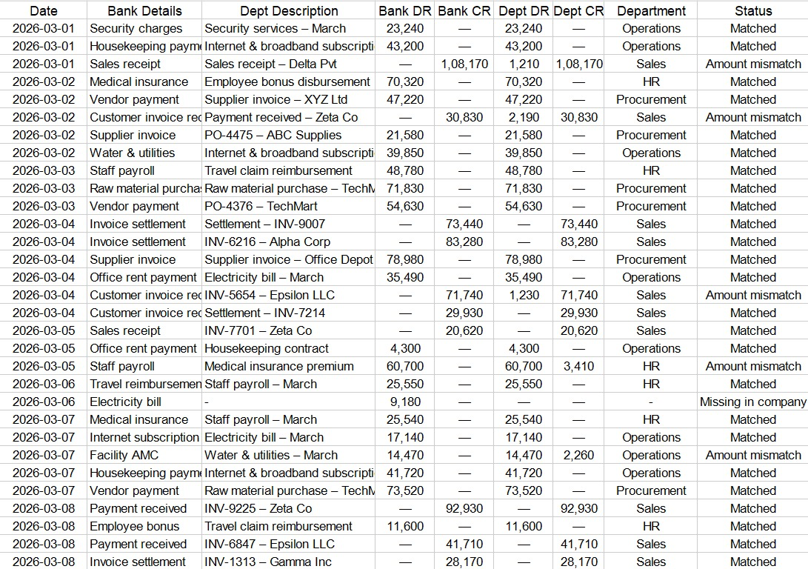
Reconciliation Report of Company A

Slide 19
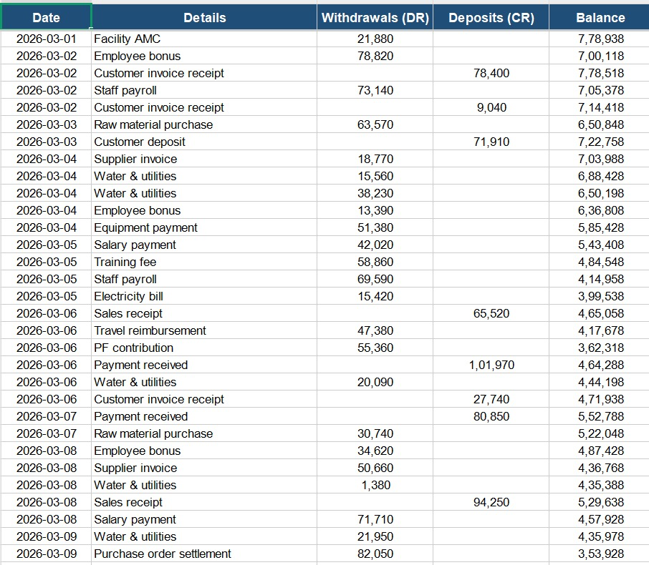
Company B bank records:

Slide 20
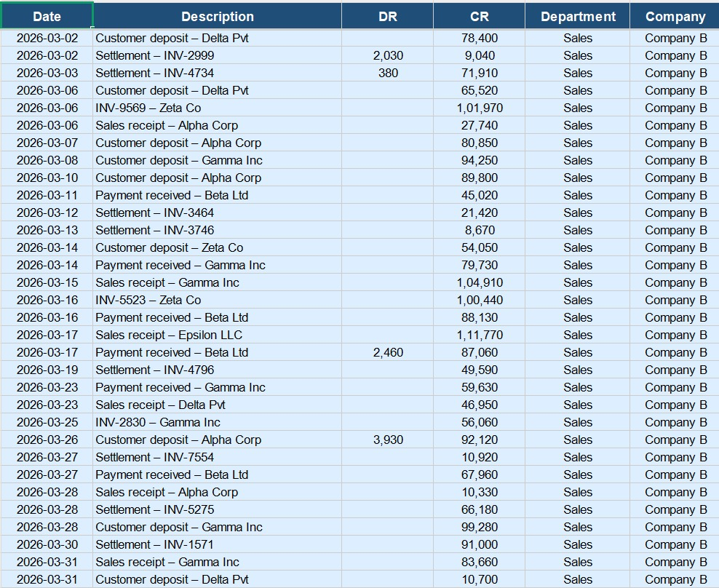
Company B records:

Slide 21
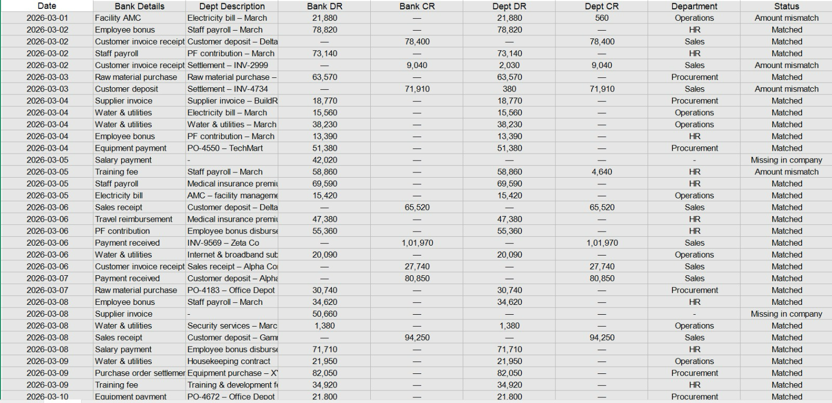
Reconciliation Report of Company B

Slide 22


References
[1] J. Wewerka and M. Reichert, “Robotic Process Automation: A Systematic Literature Review and Future Research Directions,” Business & Information Systems Engineering, vol. 62, no. 5, pp. 425–440, 2020.
[2] P. Kotla, “Automation of Financial Processes Using UiPath RPA,” International Journal of Advanced Research in Computer Science, 2024.
[3] P. Matin, “Robotic Process Automation for Automating Financial Reconciliation,” ResearchGate, 2024.
[4] UiPath, “Automating Finance and Accounting with Robotic Process Automation,” White Paper, 2019.
[5] Deloitte, “The Robots Are Ready: Are You? Untapped Advantage in Your Digital Workforce,” 2017.
[6] McKinsey Global Institute, “A Future That Works: Automation, Employment, and Productivity,” 2019.

Slide 23

Thank You

